Slide 1
Ukraine in Energy Community and the Association Agreement
Experience of push for reforms

Slide 2
Our mission is to be a motor of high-quality changes in the energy policy, to achieve new standards and practices of decision-making in the sector.
For this purpose, we:
hold policy research on relevant issues and come up good proposals,
strengthen the role of expert communities and civil society, uniting them into coalitions with higher policy impact,
create open platforms for cooperation and professional discussions,
and share best practices, knowledge and skills for successful reforms.
DiXi Group is a Kyiv-based think tank established in 2008

Slide 3
Back in 2011…
Ukraine joined the Treaty establishing EnC
No public photo of the event is left
Just to remember about the time – the year of scandal around “Boyko’s rigs”
Ratification was initiated by V.Yanukovych
Parliament supported by 371 votes out of 394 registered

Slide 4
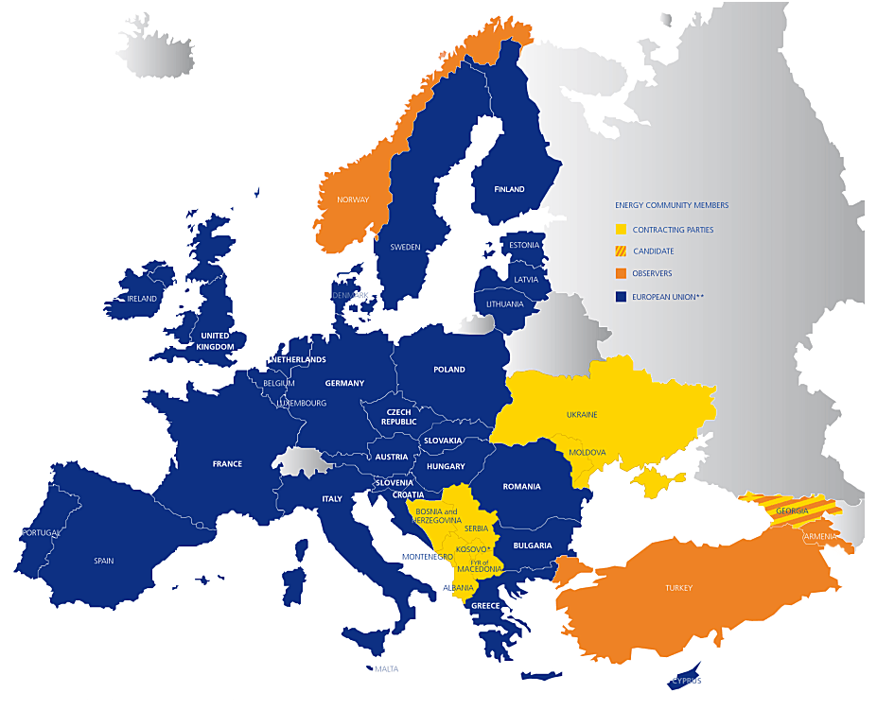
Why we did
Detailed international commitment
Action plan to follow
Law on disclosure of information in force
Perfect test for coordination and compliance
Perfect support for reforms

Slide 5

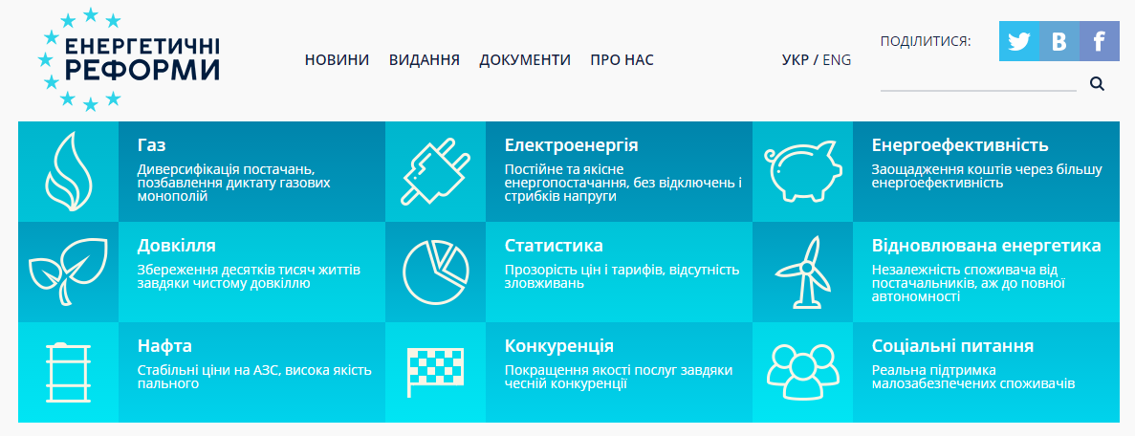
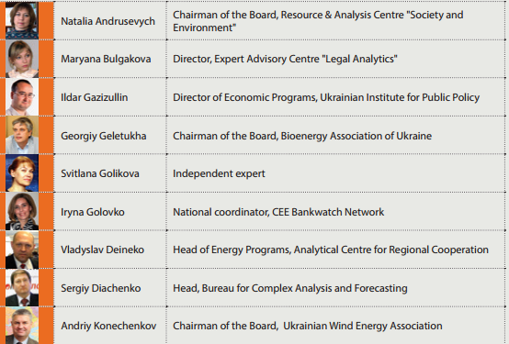
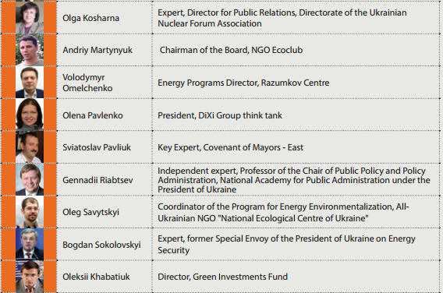
What we did
Energy Reforms coalition
Monitoring framework
Monitoring of public statements and deeds
Informational inquiries
Peer reviews
Advice

Slide 6
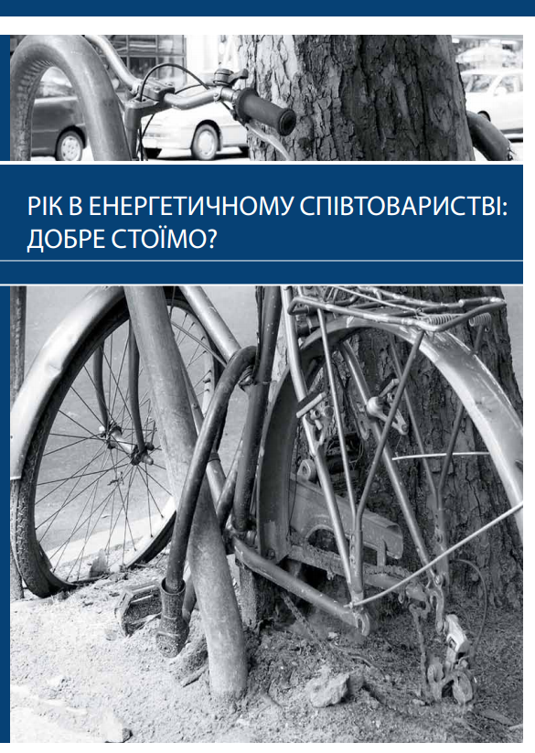
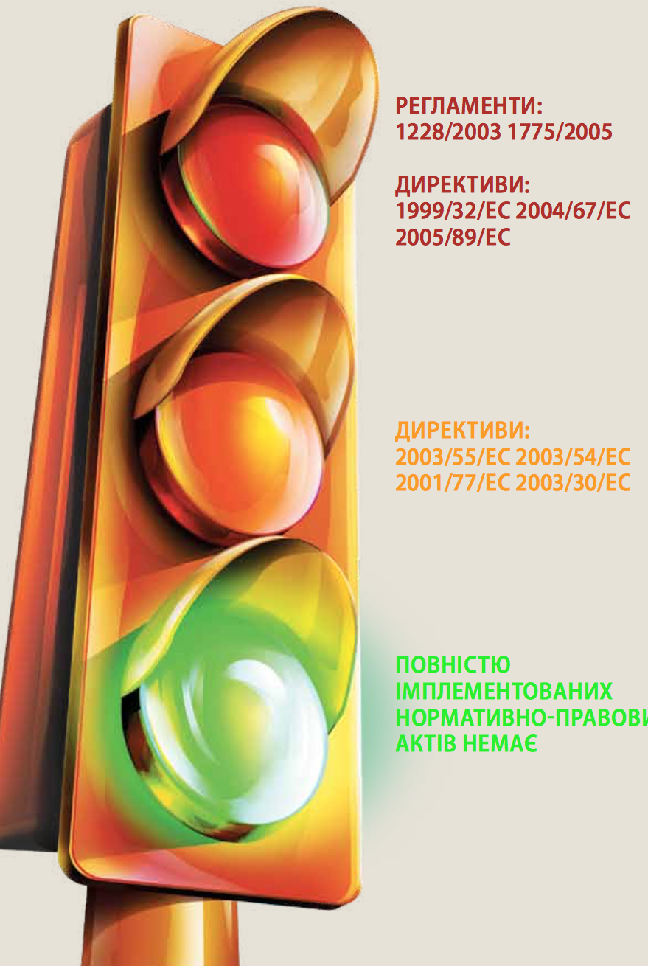
First report
Our first annual monitoring report, 2012
No commitment was fully implemented
The expectations from both sides did not match. Not publicly at first
Implementation process was closed to public
Government tried manipulate the branding and labelling
Bureaucracy influenced the process in terms of time and control

Slide 7



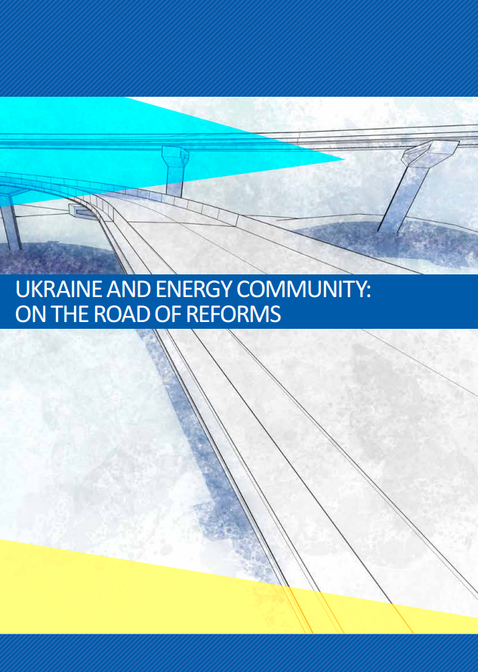
Annual reports

Slide 8
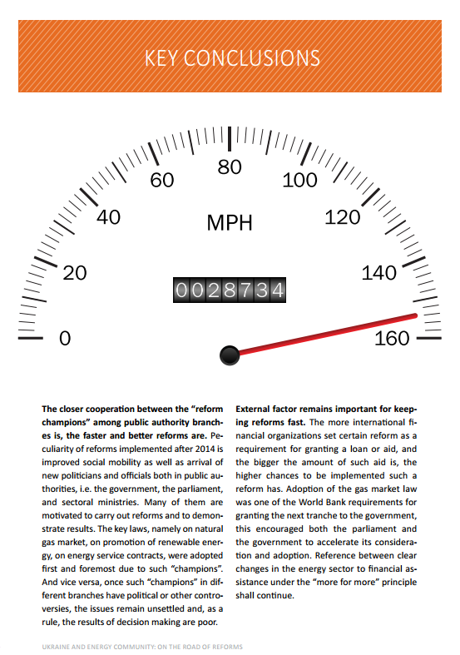

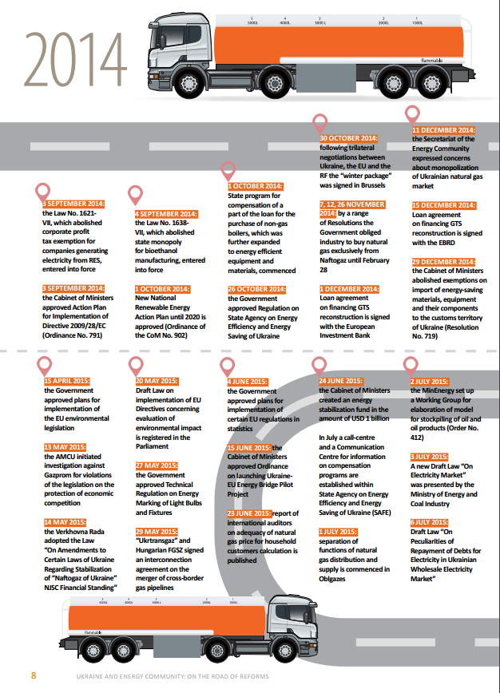
Inside the report
Provided our conclusions
and came up with recommendations to improve the process
Highlighted key dates and provided list of documents

Slide 9
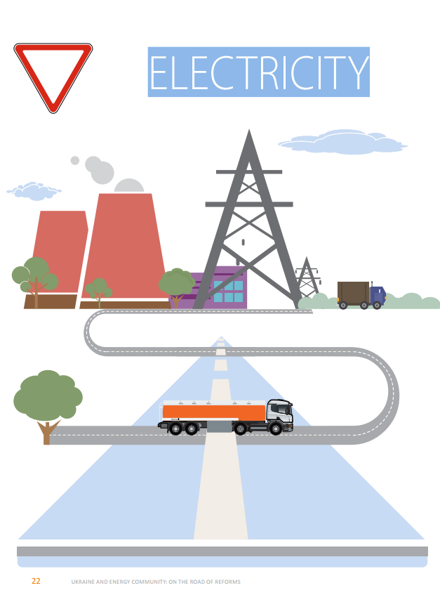
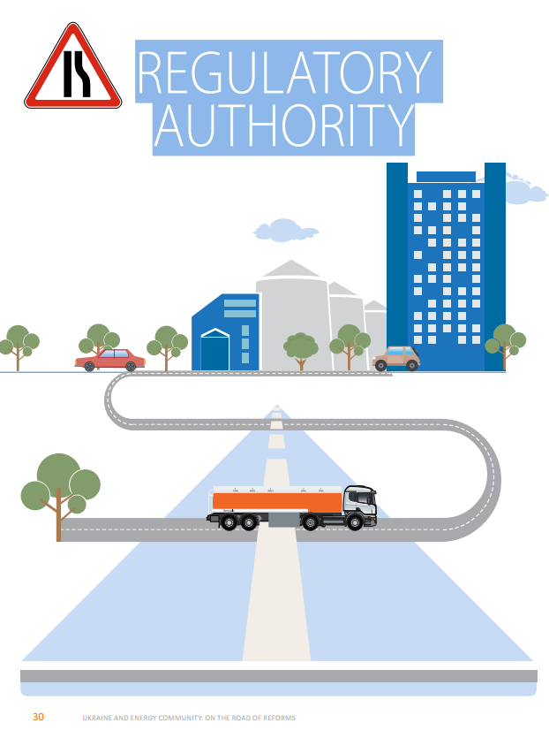
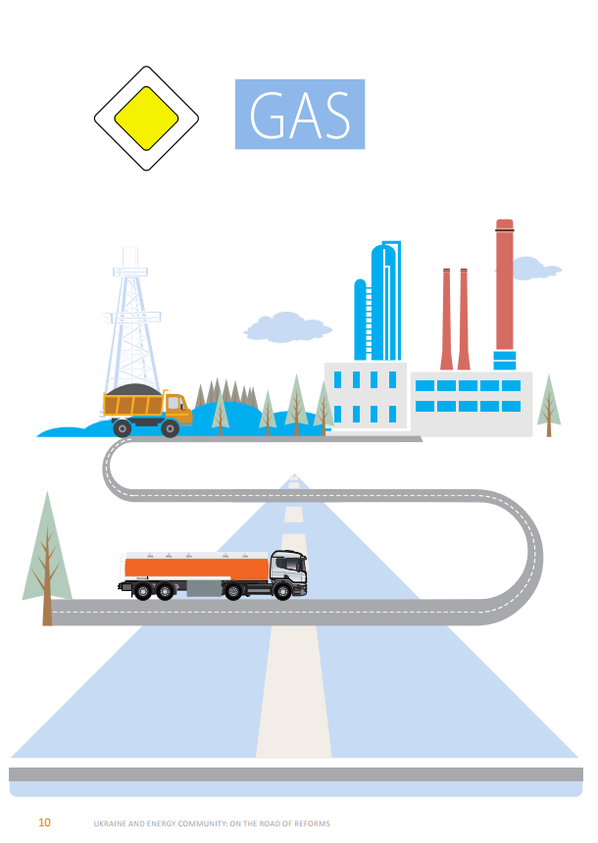
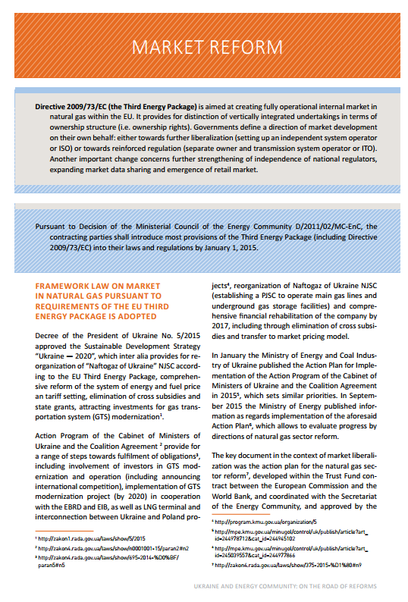

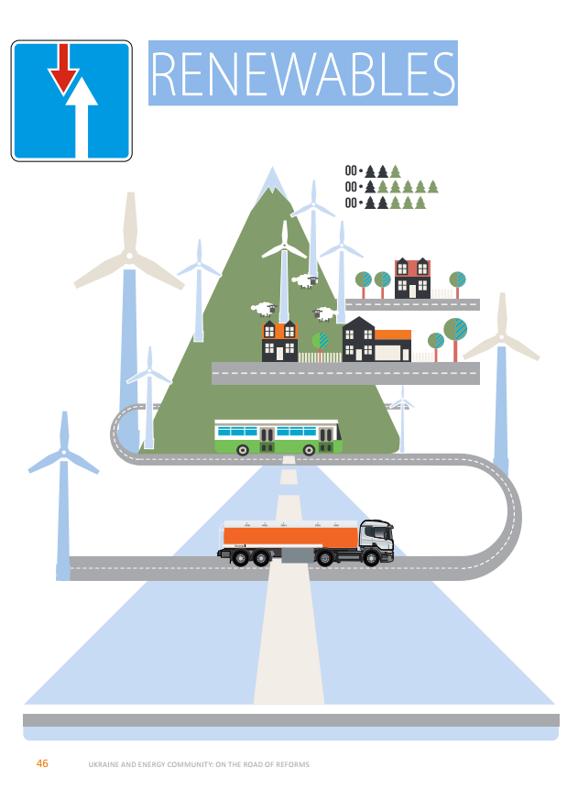


Inside the report
Topical chapters based on Directives

Slide 10
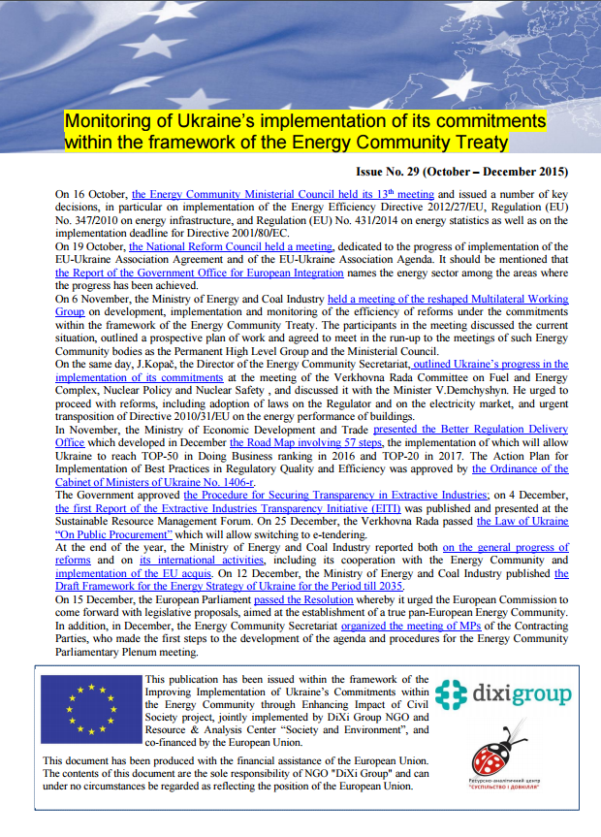
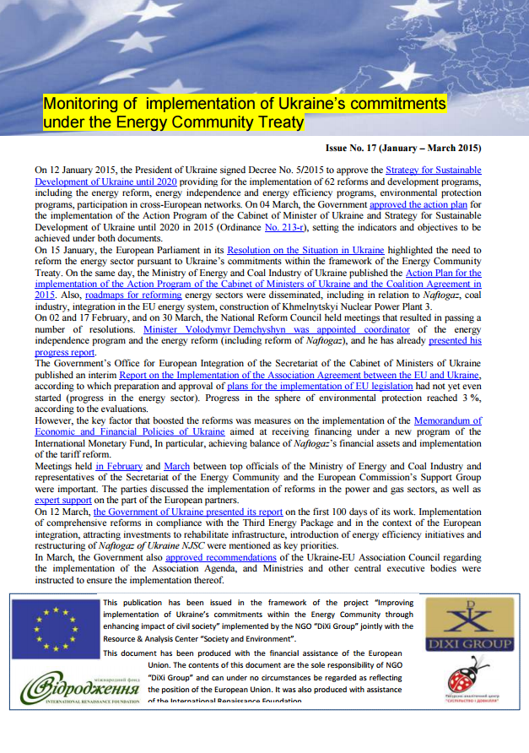
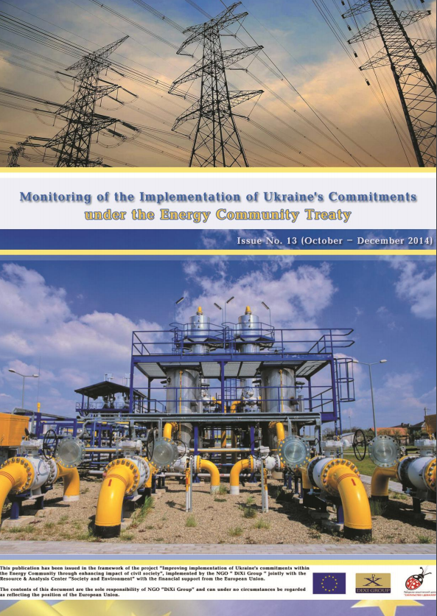
Monthly & Quarterly reports

Slide 11
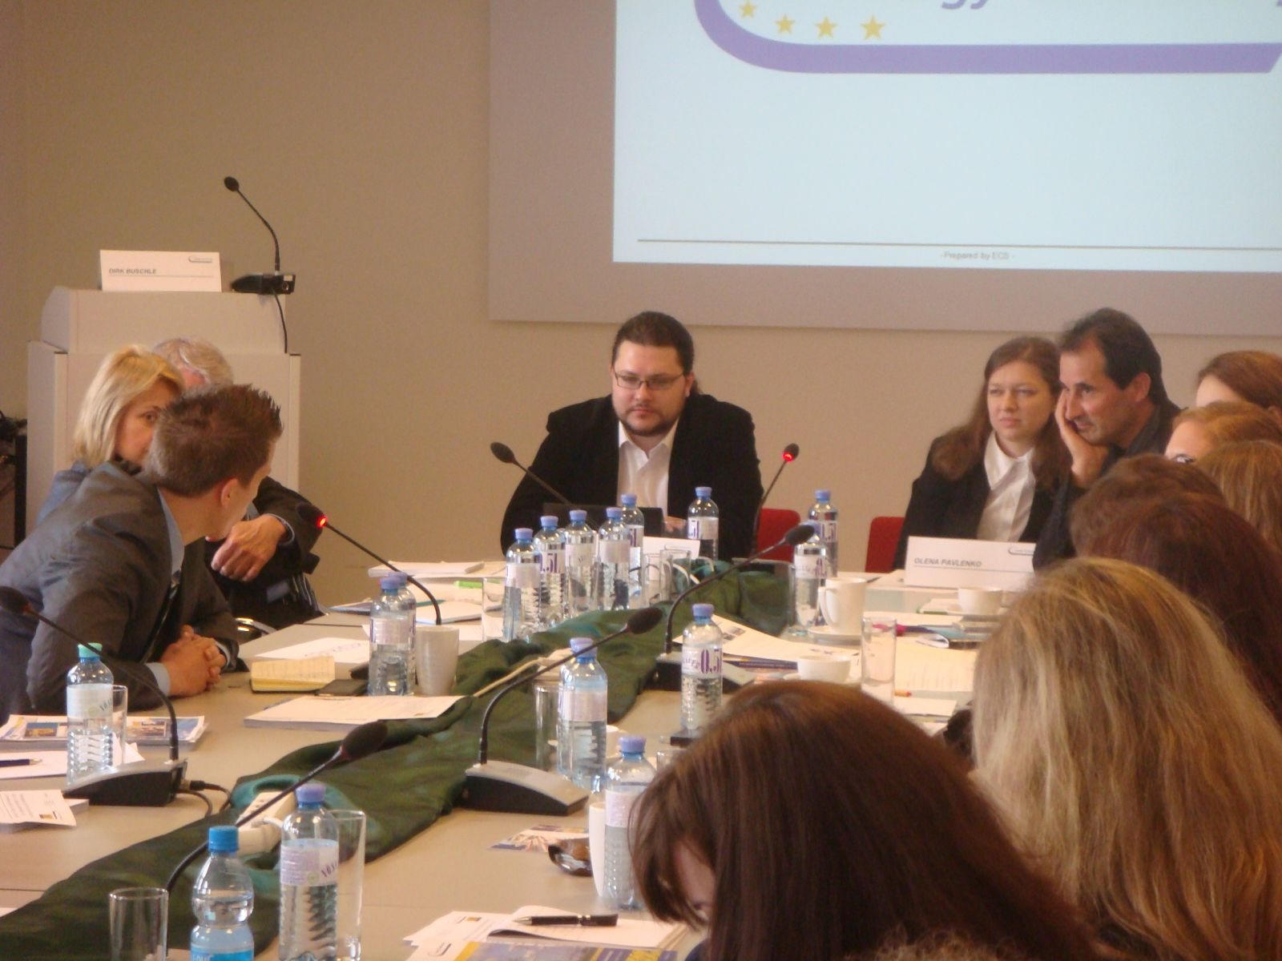
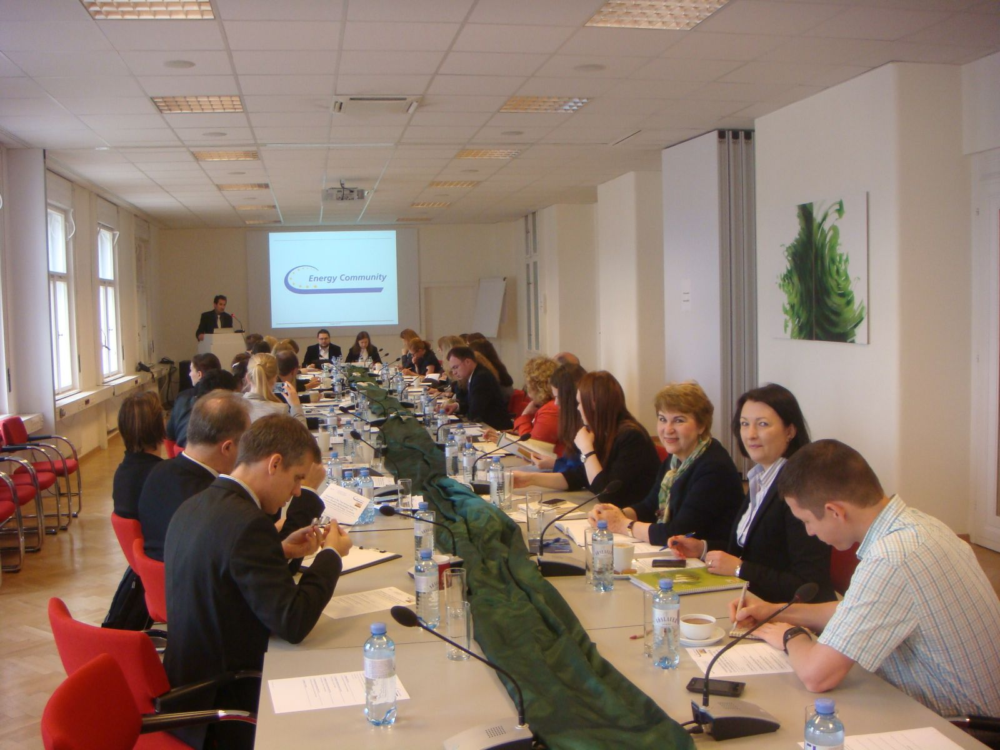
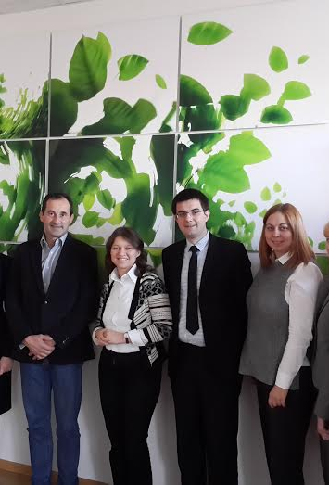
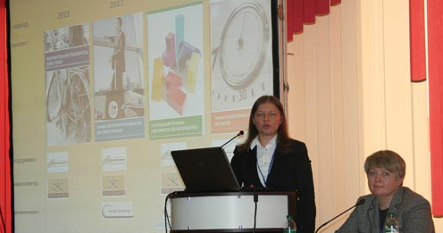
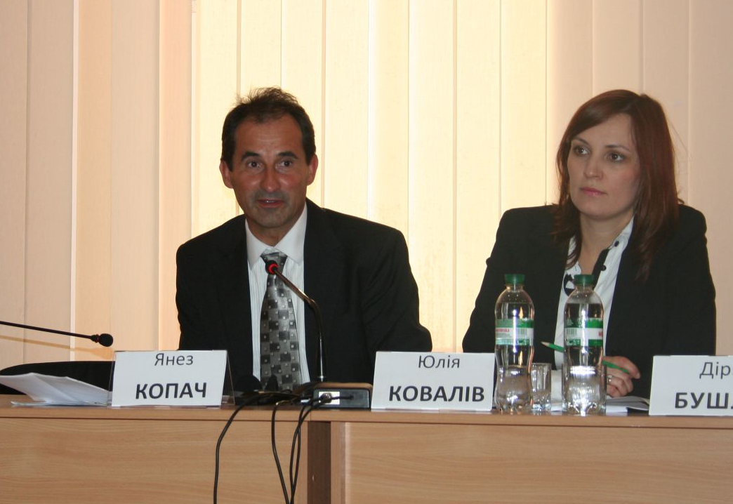
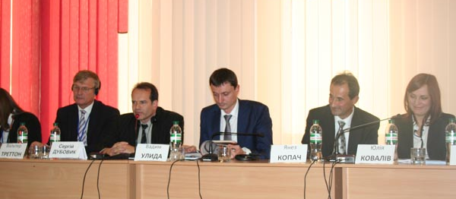
Presentations
in Kyiv, Vienna and Brussels

Slide 12
Multi Stakeholder Group
Governmental bodies in charge
Civil society
Energy Community Secretariat
Companies
Status updates
Coordination before important decision
Unblocking progress where needed

Slide 13

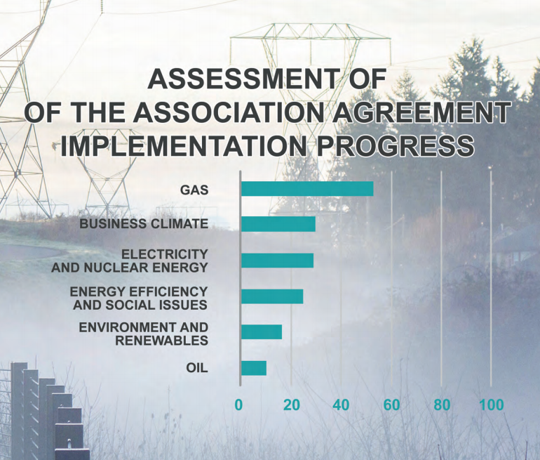
Association agreement
Updates
Key partners:
6 Task Forces
Coordinator + key expert
Benchmarks
Local component
Monthly and annual reports
Briefings, roundtable discussions

Slide 14
JOIN!
Anton Antonenko
antant@dixigroup.org

